Slide 1
Activity Recognition Using Active Learning
Dream Team
Chen Shang, Chris Sanders, Thomas Silbernagel, & Michael Towns
Notes:
Thomas

Slide 2
Area of Application
Remotely monitoring the activities of patients to ensure their safety
Hospitals
Nursing homes
Home health
Notes:
Thomas

Slide 3
Goals
Problem Statement
Comparing the accuracy of correctly labeling human physical activities using active vs non-active learning
Specific Aim
Reduce human workload by reducing number of data points needed to be labeled
Show that active learning is at least as accurate as non-active learning using three classification algorithms
Random Forest
Decision Tree
K-nearest neighbor
Notes:
Michael

Slide 4
Active Learning
Semi-supervised
Large amount of unclassified data
Interactively queries user or information source to label data that can then be used to label similar data
Requires 1/10th of labeling that is traditionally needed when classifying data
Notes:
Thomas

Slide 5








Data Source
Data collected from 7 subjects carrying smartphones (sensor data) and smart watch (manual data)
Across 2 weeks
In 7 states of posture
Includes acceleration and orientation data
Each set contains more than a million records each
Attributes
ATTR_X
ATTR_Y
ATTR_Z
ATTR_pitch
ATTR_roll
ATTR_azimuth
}
acceleration
}
orientation
Notes:
Chris
https://sensor.informatik.uni-mannheim.de/#dataset_dailylog

Slide 6
Data Integration
Before Integration
Data was vastly separated (5 separate datasets)
Data was recorded every 15 - 20 milliseconds
Several attributes overlapped datasets
After Integration
We only used attributes directly describing motion
Cut out overlapping, blank, unknown, or irrelevant data
Reduced data to one record per second
Saved posture dataset as labels
Notes:
Chris

Slide 7
Experiments
Experiment 1:
Used Day 1 data as training data (Whole Data Set)
Used Day 2 data as testing data
Experiment 2:
Used Day 1 data as training data (Part of Data Set)
Used Day 2 data as testing data
Labels:
NotSpecified
Standing ○ Sitting
Walking ○ Running
Climbing (Up) ○ Climbing (Down)
Notes:
Chen

Slide 8
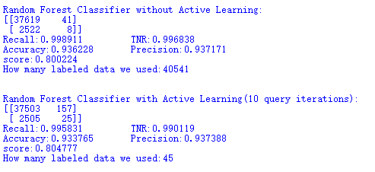
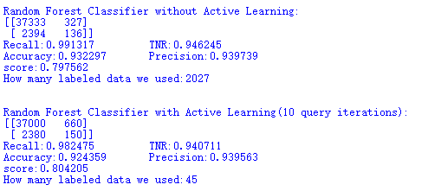
Analysis & Results (Random Forest)
Experiment 1:
Experiment 2:
Notes:
Chen

Slide 9
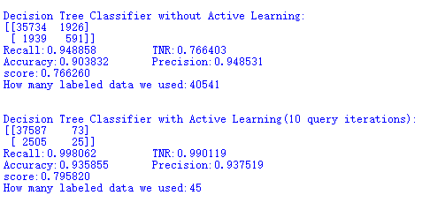
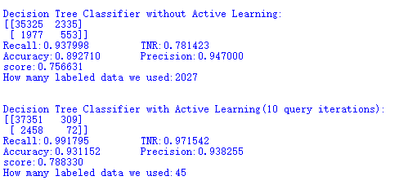
Analysis & Results (Decision Tree)
Experiment 1:
Experiment 2:
Notes:
Chen

Slide 10
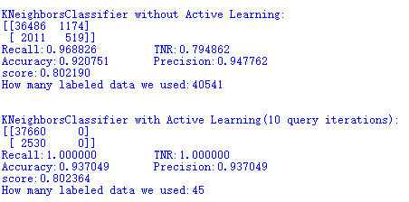
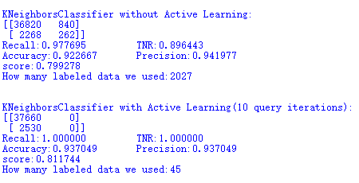
Analysis & Results (K-nearest neighbor)
Experiment 1:
Experiment 2:
Notes:
Chen

Slide 11
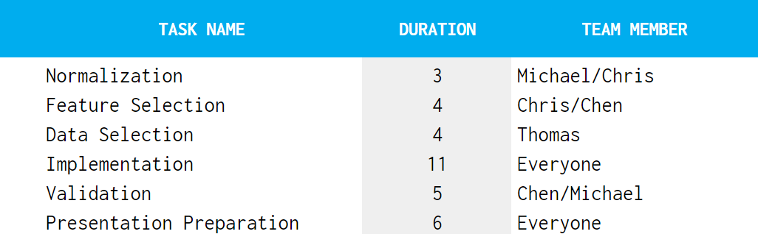
Timeline
Notes:
Thomas

Slide 12
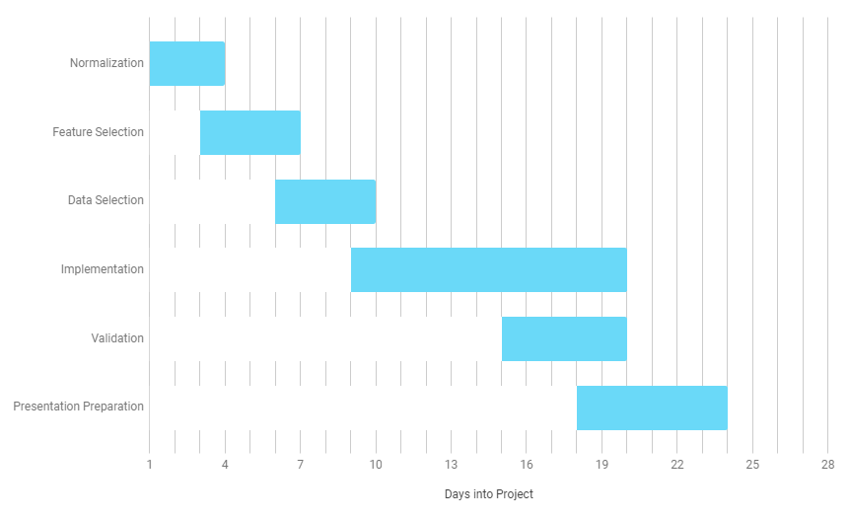
Gantt Chart
Notes:
Michael

Slide 13
Classification of Active Learning Enabled Activity Recognition
Dream Team
Chen Shang, Chris Sanders, Thomas Silbernagel, & Michael Towns
Notes:
Michael

